Slide 1

What in the world is going on?
A Global View
CFGC Recertification Training
03 March 2022
CH (LTC) Kevin Mateer
Kevin.mateer@yahoo.com
360-306-1677

Slide 2

DISCLAIMER
I do not have all the answers
1. Present for 45 minutes or until you are all standing around the room.
2. Answer questions- consider different perspectives
3. Pray for God’s intervention
I DO NOT SPEAK FOR ANYONE:
ARCYBER, US ARMY or USG.
BLUF-I BELIEVE RELIGION SIGNIFICANTLY THREATENS AUTHORITARIAN REGIMES AND THEIR DRACONIAN RESPONSES HAS GOD’S ATTENTION
Notes:
2

Slide 3

Global Perspective

Slide 4
Global Perspective
Russia- China
Russia-Ukraine
Afghanistan-China
US-China
China-Taiwan-Tibet

Slide 5
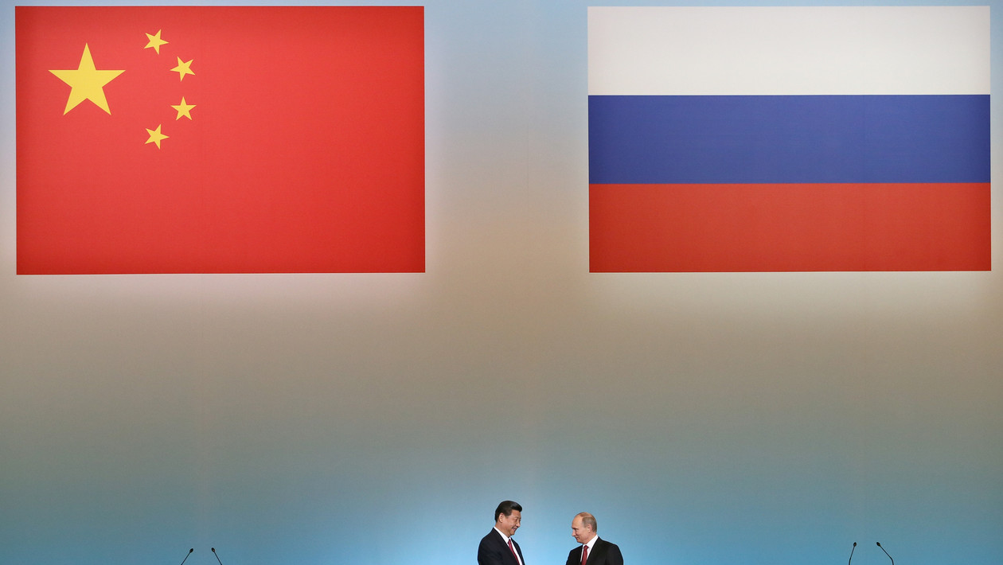
China and Russia participation
These trends continue as before, but Russia’s invasion of Ukraine has made managing them even more difficult. Yet another disastrous result of this war will be the hardening of the Russia-China partnership that it augurs. A sanctioned Russia will rely ever more heavily on Chinese support including on Chinese purchases of Russian energy and access to Chinese payment systems. As damaging as Western sanctions will be to Russia, isolating Russia is not possible if China continues to provide this outlet.

Slide 6
Unholy Alliance between China & Russia
…after the botched withdrawal of troops from Afghanistan, if Russia invades Ukraine in any capacity and the U.S. does not retaliate with a forceful and sufficiently decisive response, the CCP will be emboldened to take aggressive action against Taiwan.
Further, if Taiwan feels that the United States — their most prominent and steadfast supporter of the island’s independence — is an unreliable international partner, Taiwan may be more willing to accept the terms of mainland China’s rule out of fear.
Ultimately, the U.S. must begin waging a more forceful defense of democratic values in Ukraine, Taiwan, and around the world.
In this war — the war between democracy versus autocracy — the world order is on the line, freedom is on the line, and human rights everywhere are on the line.
Notes:
https://thehill.com/opinion/international/594927-the-risks-and-implications-of-china-and-russias-unholy-allianceDouglas E. Schoen is a political consultant who served as an adviser to former President Clinton and to the 2020 presidential campaign of Michael Bloomberg. He is the author of “The End of Democracy? Russia and China on the Rise and America in Retreat."

Slide 7
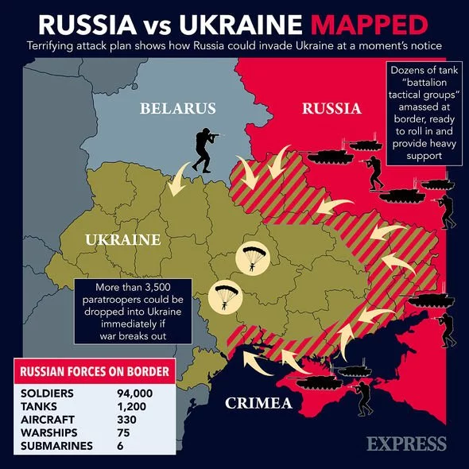
Russia-Ukraine
What do we need to Know?

Slide 8
Putin’s Speech about the Russian Narrative, November 4, 2016
In the very heart of Moscow, across from the Kremlin is a Statue christened in 2016 of Prince Vladimir. He ruled from 980-1015 in the city of Kiev where he left a legacy by accepting the Christian religion for himself and his realm– the medieval state of Kyivan Rus; which included vast territories extending from the Carpathian Mountains in the west to the Volga River in the east.
The importance of the monument symbolizes the Russian claim for Kyivan heritage and underlines the importance of Kyivan Rus for the historical identity of contemporary Russia. First stone was laid in 2015 after Russia annexation of the Crimea, Ukraine.
Otherwise, what would a monument to a prince of Kyiv, the capital for the neighboring state of Ukraine, be doing in such a coveted space in the very heart of Moscow, across the square from the Borovitsky gate of the Kremlin, the tallest monument in the Russian Capital.

Slide 9
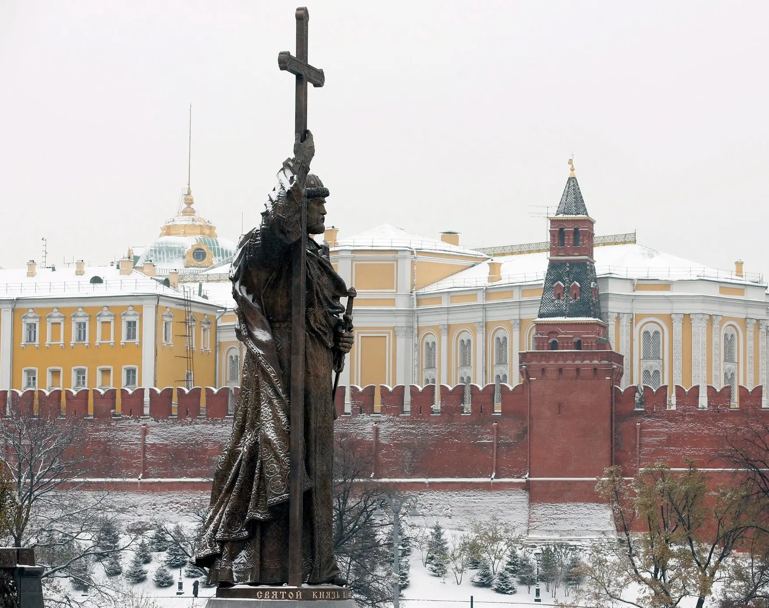
The question of Russian identity and its geographic extent is more than academic interest, as it influences issues of War and Peace along Europe’s eastern frontiers today and will influence them for generations to come.

Slide 10
The question of Russian identity and its geographic expansion is more than academic interest, for it influences issues of War and Peace along Europe’s eastern frontiers today and will influence them for generations to come.

Slide 11
Should Americans care about Ukraine-Russia conflict?
Another important dimension to U.S. involvement in the crisis has to do with its support of Ukraine as a democracy. Since 1991, when Ukraine declared its independence…"Democracy in Ukraine is worth protecting," he continued. "Democracy is our best guarantee against war and best assurance of peace.“
"Make no mistake, the United States will defend every inch of NATO territory with the full force of American power," Biden said this week. "An attack against one NATO country is an attack against all of us."
Notes:
https://abcnews.go.com/International/americans-care-ukraine-russia-conflict/story?id=82907932

Slide 12
Putin to denazify Ukraine
The Russian leader said that one of the goals of the offensive was to “denazify” the country, part of a long-running effort by Putin to delegitimize Ukrainian nationalism and sell the incursion to his constituency at home.
Three of Zelensky’s great uncles were executed as part of the German-led genocide of European Jews during the war, the president said on a trip to Jerusalem in 2020. His grandfather, who was the brother of those killed, survived.
“Forty years later, his Jewish grandson became president,” Zelenksy said in an address.
The Ukrainian leader also fired back at Putin’s Nazi claim Thursday, saying on Twitter that Russia had attacked Ukraine just “as Nazi Germany did.”
One of World War II’s worst massacres took place near the Ukrainian capital in 1941, when German-led forces killed tens of thousands of Jews in the ravine of Babi Yar.
“As of today, our countries are on different sides of world history,” Zelensky said on Twitter, addressing Putin. “Russia has embarked on a path of evil.”
Notes:
The Washington Post
Putin says he will ‘denazify’ Ukraine. Here’s the history behind that claim.
Miriam Berger - Thursday

Slide 13
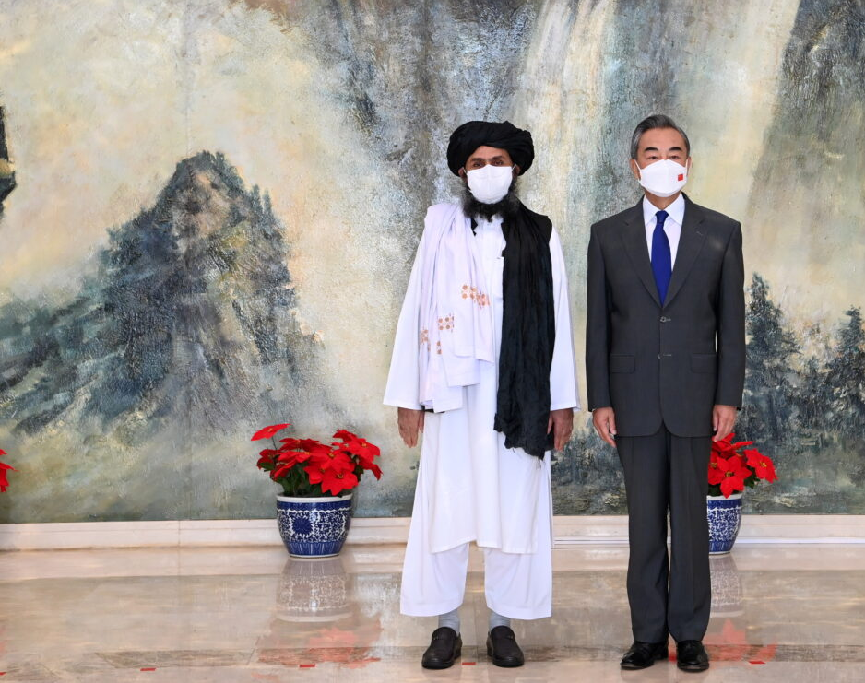
Why are the Chinese state and the Taliban meeting?
The Taliban takeover of Afghanistan gave the Chinese regime a golden opportunity to criticize the United States and deepen its own influence. And it wasted no time to seize it.

Slide 14
Rare Earth and Afghanistan cooperation with China
Take, for example, so-called rare earth minerals. According to the Department of Energy, China refines 60 percent of the world’s lithium, 80 percent of the world’s cobalt, and mines 68 percent of the world’s graphite, three core inputs to high-capacity batteries. China’s battery industry has also benefited from at least $100 billion in direct government subsidy.
This advantage in high-capacity batteries and their raw materials in turn creates a competitive advantage that China will exploit as the world moves to electric vehicles. China already outproduces the U.S. in vehicle production generally. The U.S. built about 15 million cars overall in 2021, compared to China’s 24 million. And China is moving rapidly to displace other makers of electric vehicles. Thanks to cheap labor and state subsidy, China can sell an electric car for about $15,000 less than the cheapest comparable U.S. car. And, amazingly, made-in-China electric cars still qualify for the $7,500 tax credit in the U.S.
What will the US infrastructure bill provide 500 million dollars to build?
Who will have the batteries to make the electric cars to meet production requirements?
Notes:
China: Epicenter of the Supply Chain Crisis
How concentrating dependence on China upended our economy and added risk
BY ROBERT KUTTNER
FEBRUARY 1, 2022

Slide 15
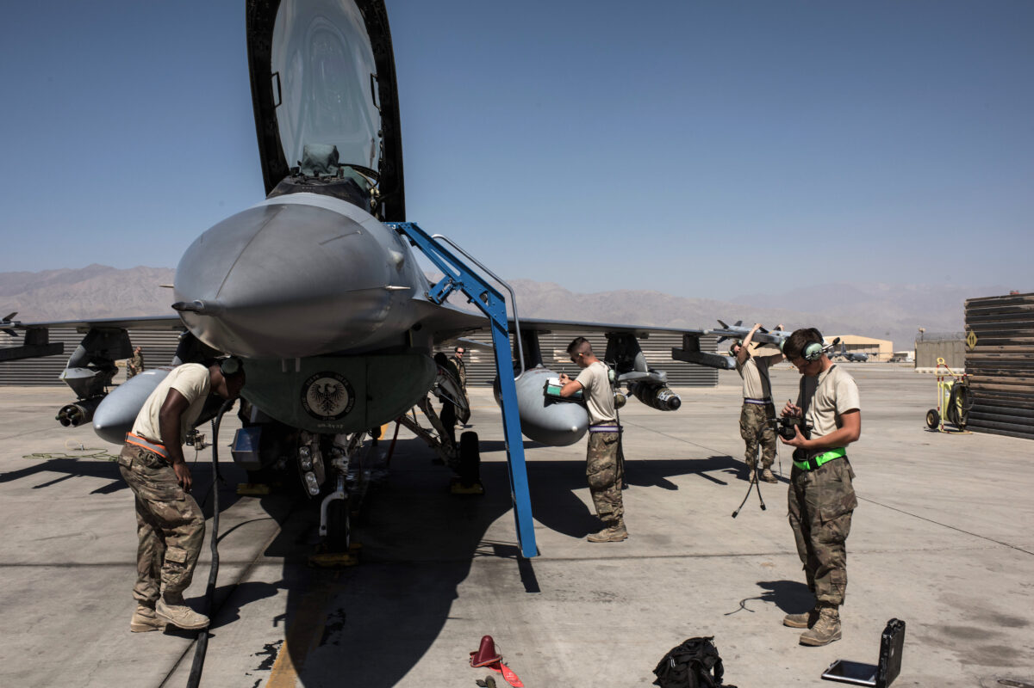
US leaves Bagram AFB
July 1, 2021
One of the construction projects completed by the United States at the airfield is a 12,000 foot (3,660 meters) runway, which opened in 2016 at the cost of $68 million.
The U.S. airfield was determined by the Pentagon to be neither tactically nor operationally necessary, Chairman of the Joint Chiefs of Staff General Mark Milley told a congressional hearing in late June 2021.
Less than two weeks later, the U.S. military left Bagram airfield.
June 30, 2021 WP reports researchers using commercial satellite images spotted 119 construction sites where they say China is building silos for intercontinental ballistic missiles. The image has been annotated to show site locations. (Planet/Center for Nonproliferation Studies)
What word is missing from this highlighted phrase?

Slide 16

China’s new ICBM site
The construction boom suggests a major effort to bolster the credibility of China’s nuclear deterrent, said researcher Jeffrey Lewis, an expert on China’s nuclear arsenal and part of a team that analyzed the suspicious sites, first by commercial satellites over northwestern China. Lewis described the scale of the building spree as “incredible.”
“If the silos under construction at other sites across China are added to the count, the total comes to about 145 silos under construction,” Lewis, director of the East Asia Nonproliferation Program at the Center for Nonproliferation Studies, part of the Middlebury Institute of International Studies, said in a summary of his findings provided to The Washington Post. “We believe China is expanding its nuclear forces in part to maintain a deterrent that can survive a U.S. first strike in sufficient numbers to defeat U.S. missile defenses.”

Slide 17
Strategic Deterrent
A recent report by the Federation of American Scientists (FAS) revealed that China has been secretly building three missile silo fields near Yumen, Hami, and Orodos in western China, the region that neighbors Afghanistan. The report concluded that China is engaging in an “unprecedented nuclear buildup” and China’s total Intercontinental ballistic missile force “could potentially exceed that of either Russia and the United States in the foreseeable future.”
Dan Steiner, a retired U.S. Air Force colonel and global strategist, previously told The Epoch Times that keeping Bagram airfield, given its proximity to China, would have given the United States a “strategic advantage” in contending with threats posed by Beijing.
Do we need a STRATEGIC advantage over CHINA?
Notes:
EXCLUSIVE: Trump on Afghanistan Withdrawal: ‘China Is Going to Have Bagram’
By Frank Fang and Kash's Corner
February 4, 2022 Updated: February 4, 2022

Slide 18
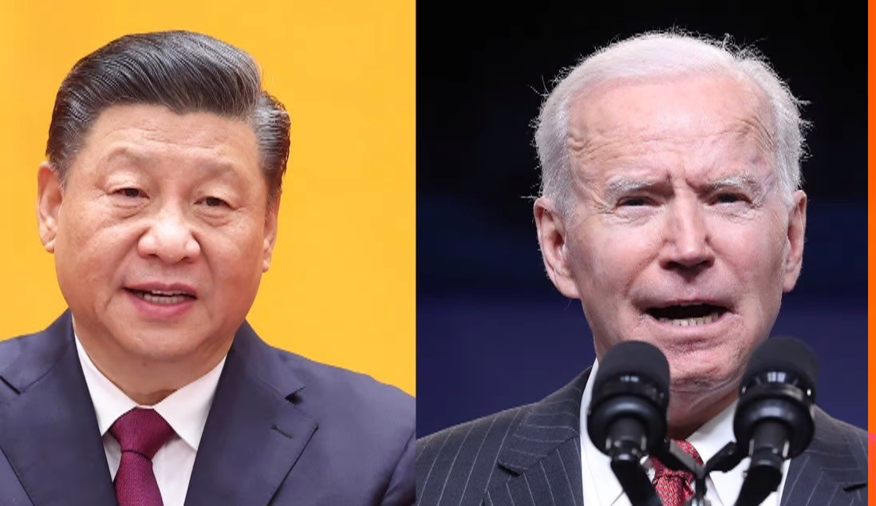
China and the United States
History Lesson
Corona Virus
Opioids
Elite Capture
Olympics
One China Policy
Taiwan & Tibet

Slide 19
Impact of Religion: China and nK
China Believes Religion and Opium Caused a Century of Humiliation
China’s narrative: Christianity, as an expression of Western Powers, caused a century of humiliation.¹
The Opium Wars, the result of British enforced trade and the influx of western missionaries, led to the destruction of the Manchu dynasty.
The Taiping Rebellion, the result of Western culture and beliefs moving into China, with Christianity at the center of Taiping ideology, led to 20 million killed.²
The Boxer Rebellion, the justifiable expulsion and deaths of Chinese Christians and Foreign missionaries, led to eight Western nations leveling crippling reparations against China.³
China’s response: Chinese cultural revolution and imperial power
Chinese cultural revolution established the Atheist Communist Party and aggressively sought to eliminate all Western thought.
The cultural revolution targeted religion. The Chinese government emphatically declared religion no longer exists. Mao’s wife even stated upon Mao’s death, “Christianity in China has become history; it is now dead and buried.”⁴
President Xi’s narrative asserts that China can become a great power only under the party, and only under his leadership.⁵
Notes:
¹ David Aikman, Jesus in Beijing. Regnery Books; (Washington DC. 2003), p. 43.
² Susan Shirk, The Legacy of Tiananmen for Chinese Politics, Huffington Post; June 3, 2009.
³ Aikman, p. 42.
⁴ Aikman, p.213.
⁵ Tobin Harshaw, “Emperor Xi’s China Is Done Biding Its Time,” Bloomberg; March 3, 2018.

Slide 20
THE THIRD OPIUM WAR
One official suggested calling the “Fentanyl scourge” the “Third Opium War.” The response from inside the beltway was immediate and visceral, “You can’t say that” (when it comes to China). In this case, the response was particularly curios as, payback for the Opium Wars were 180 years ago (Great Britain).
That the Chinese regime doesn’t ban fentanyl in its entirety-much less go after producers the way it goes after Uighurs, Christians, and Falun Gong, or Hong Kongers- suggests China is glad America is awash in fentanyl.
The carnage can’t be overstated. Fetanyl is ravaging all parts of American society.
Notes:
America’s Chinese Fentanyl Flood, Epoch Times, August 4, 2021, A15. By Grant Newsham

Slide 21
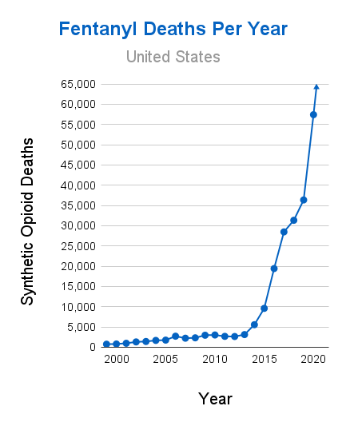
Fentanyl leading cause of death 18-45
WASHINGTON (TND) — The number one killer of Americans aged 18 to 45 is now fentanyl overdoses, with nearly 79,000 people in the age range dying to them between 2020 and 2021, according to newly released data, "Families Against Fentanyl," an opioid awareness organization, analyzed the data from U.S. government sources and found 37,208 died in 2020
and 41,587 died in 2021. Comparatively, data says COVID-19 killed more than 53,000 in the demographic in the same time period.
Fentanyl overdoses reportedly surpassed suicide,
COVID-19, and car accidents as the leading
cause of death for the demographic.
Notes:
Fentanyl Overdoses Become Leading Cause of Death in 18- to 45-Year-Olds
By Charlotte Cuthbertson
December 19, 2021 Updated: December 20, 2021

Slide 22
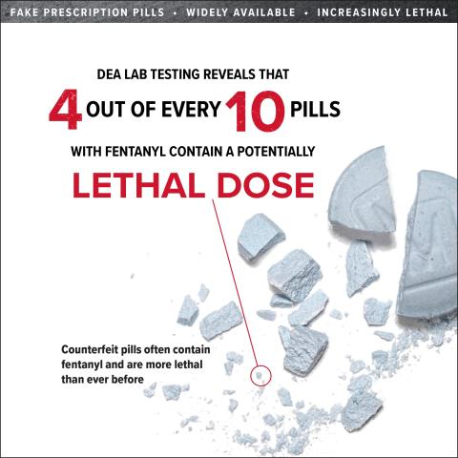
Lethal Dose 40%
An estimated 93,331 overdose fatalities in the United States last year – an all-time high. 5X the murder rate, the deadly overdose toll was primarily caused by fentanyl, a highly lethal synthetic opioid. It’s manufactured mostly by Mexican cartels with ingredients imported from China, and then smuggled over the southwestern U.S. border. Fentanyl has been arriving in larger quantities each year since at least 2016.
Fentanyl’s potency – at 50 times the strength of heroin – makes it so deadly.
Many counterfeit pills are made to look like prescription opioids such as oxycodone (Oxycontin®, Percocet®), hydrocodone (Vicodin®), and alprazolam (Xanax®); or stimulants like amphetamines (Adderall®).
Former law enforcement officials say the cartels are orchestrating the surge, overwhelming the capacity of agents to pursue drug smugglers. They can freely enter Texas, New Mexico, Arizona and California carrying fentanyl while agents are diverted to the time-consuming duty of apprehending and processing migrants.
Where are the labs that produce Fentanyl ?
Notes:
How Migrant Surge at the Border Fuels Massive American OD's From Tiny Grains of This Killer Drug
By Vince Bielski, RealClearInvestigations
November 04, 202

Slide 23
CNN POLL-COVID 19 Origins
By a nearly 2-to-1 margin, respondents said they believed Covid-19 leaked from a lab in Wuhan, China. When asked if they believed Covid-19 originated in nature or if it leaked from a Chinese lab, 53 percent said it leaked from a lab, while just 28 percent said they believe it arose organically from nature. The poll’s findings that most Americans believe China created Covid-19 are especially striking given attempts by left-wing social media corporations over the last two years to censor users who expressed skepticism of the so-called natural origins theory.
Perhaps unsurprisingly, an overwhelming majority of likely voters said they did not trust the corporate news media to tell them the truth. In fact, 75 percent of respondents said they believe the corporate news media misrepresents facts in an effort to push a political agenda on their readers and viewers. Only 15 percent of those polled said they trust the corporate news media to tell the truth.

Slide 24
Is the US letting China off the hook on COVID-19 coverup
It appears likely that Anthony Fauci, director of the National Institute of Allergy and Infectious Diseases, and his then-boss, Francis Collins, former director of the National Institutes of Health (NIH), began funding risky experiments at the WIV so as to circumvent the restrictions in the U.S. on “gain of function” research — or altering the genetic make-up of pathogens to enhance their virulence or infectiousness. The NIH money was routed through the New York-based EcoHealth Alliance, whose largest source of funds is the Pentagon. The Pentagon has yet to unequivocally deny that any of the almost $39 million it gave to EcoHealth Alliance ended up in Wuhan.

Slide 25
FOIA documents released reports from 2014+
Richard Ebright, a molecular biologist at Rutgers University, said the documents – obtained via a Freedom of Information Act request — made it clear that Fauci had been “untruthful” about gain-of-function research.
“The documents make it clear that assertions by the NIH Director, Francis Collins, and the NIAID Director, Anthony Fauci, that the NIH did not support gain-of-function research or potential pandemic pathogen enhancement at WIV are untruthful,” he tweeted.
“The materials show that the 2014 and 2019 NIH grants to EcoHealth with subcontracts to WIV funded gain-of-function research as defined in federal policies in effect in 2014-2017 and potential pandemic pathogen enhancement as defined in federal policies in effect in 2017-present.”
Gary Ruskin, executive director of U.S. Right To Know, told the Intercept that the documents provided a “road map to the high-risk research that could have led to the current pandemic.”

Slide 26
Scientists Who Promoted Natural Origin Narrative Received Over $50 Million From Fauci’s NIAID
Four prominent scientists who played key roles in shaping the natural origin virus narrative received more than $50 million from Dr. Anthony Fauci’s NIAID in 2020 and 2021.
The NIAID funding represented a substantial increase when compared to what these scientists had received before their promotion of Fauci’s natural origin narrative.
Some of the funding increases came through an entirely new program. Two of these coveted grants went to scientists who were co-authors of the influential natural origin paper “Proximal Origin.” Both men were on Fauci’s Feb. 1 secret teleconference and privately said a lab leak was likely.
The third grant went to EcoHealth President Peter Daszak—just two months after President Donald Trump ordered Fauci to cancel Daszak’s funding after Daszak’s entanglements with the Wuhan Institute of Virology came to light.

Slide 27
President Xi emergency speech to CCP
A national system to control biosecurity risks must be put in place “to protect the people’s health,” Xi said, “Instructions to strengthen biosecurity in microbiology labs that handle advanced viruses like the novel coronavirus.” How many “microbiology labs” are there in China that handle “advanced viruses like the novel coronavirus”? ONE!
The epicenter of the epidemic. China’s only Level 4 microbiology lab that is equipped to handle deadly coronaviruses, is the Wuhan Institute of Virology.
PLA’s top expert in biological warfare, a Maj. Gen. Chen Wei, was dispatched to Wuhan at the end of January to help with the effort to contain the outbreak.
Chinese Ministry of Science and Technology released a new directive titled: “Instructions on strengthening biosecurity management in microbiology labs that handle advanced viruses like the novel coronavirus.”
How many “microbiology labs” are there in China that handle “advanced viruses like the novel coronavirus”?
Just one! The Wuhan Institute of Virology.
Notes:
Don’t buy China’s story: The coronavirus may have leaked from a lab
By Steven W. Mosher

Slide 28
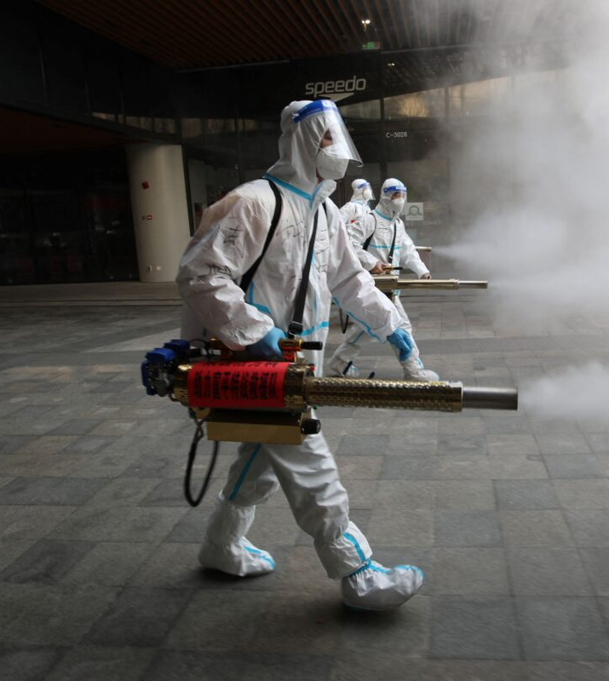
China’s True COVID-19 Death Toll
The Chinese regime has likely understated the country’s COVID-19 death rate by as much as 17,000 percent, in a systematic data-suppression campaign to sustain its political image, according to a U.S. analyst.
That would put the number of COVID-19 deaths in China at around 1.7 million rather than 4,636, the two-year cumulative death figure that the Chinese authorities have maintained. That’s 366 times the official figure.
Those findings, made by George Calhoun, director of the quantitative finance program at Stevens Institute of Technology, were based on data as of January generated by a model developed by The Economist.

Slide 29
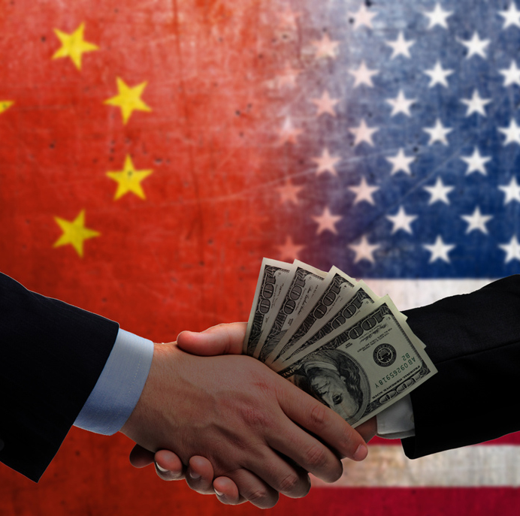
Elite Capture
While researching how Americans having been getting rich by helping the Chinese Communist Party achieve its outspoken aim of replacing the US as the "world's No.1 power," I came across the phrase "elite capture" -- their term to describe the actions of influential people in the US towards China.
As the muckraker and novelist Upton Sinclair wrote, "It is difficult to get a man to understand something when his salary depends on his not understanding it."

Slide 30
Elite capture
This isn’t ordinary diplomacy it is the power wielded by those who succumb to the temptation. The public activities and statements of some of the most powerful people in the US. From the world of Silicon Valley, we explore Mark Zuckerberg of Facebook, Tim Cook of Apple, and Bill Gates of Microsoft. From the world of Wall Street, we looked at Ray Dalio of Bridgewater, the largest hedge-fund investment company in the world, and Larry Fink of BlackRock. From academia we explored the actions of Harvard and Yale universities. We surveyed the relationship histories of the Bush family, the Trudeau family of Canada, the Pelosi family, and of course, the Biden family.

Slide 31
Higher Education
Nathan Law-Time magazine Top 100 Most influential People of 2020.
Age 21 involved in Umbrella movement; then founded a prodemocracy group called Demosito.
Age 23 elected to HK legislature; went to jail 8 months
Attended Yale Grad school. Faced harassment by hundreds of students from mainland China all supportive of the regime.
Joe Tsai, Billionaire tech entrepreneur and Yale graduate, donated 30 million to the China center at Yale U.
Joe Tsai has enormous wealth estimated at $10billion is courtesy of his involvement with the Chinese tech giant Alibaba.
Alibaba also has key allies connected to the highest levels of the Chinese govt. critical to the companies rise.
Listed on the New York stock exchange has heavy ownership of CCP elite.
Alibaba also has close ties to the Chinese.
Joe Tsai has been outspoken in his defense of the regime. While Alibaba is based in China, His family lives in California.
Yale has strong ties to China’s elite. Today, more than 800 Chinese students and about 800 Chinese scholars are in residence at Yale.
Yale’s financial interests are increasingly decoupled from American markets and more closely tied to markets over seas, including China.
China officials want research partners in science and technology to enhance their ability to steal technology and intellectual property.
How much intellectual property does China steal every year from the United States? 225-600 Billion Dollars each year.

Slide 32
The Department of Justice charged Chinese telecommunications giant Huawei Monday on several counts of fraud
A 13-count indictment against Huawei and its chief financial officer,
Meng Wanzhou, accuses Huawei of bank fraud, wire fraud,
and violating U.S. sanctions on Iran.
Huawei is also charged
with conspiring to obstruct justice related to the DOJ’s investigation.
Meng, the CFO of Huawei and daughter
of the company’s founder, was arrested in December in Vancouver by the Canadian Justice Department.
China warned Canada in December that it faces “severe consequences” if officials don’t release the executive.

Slide 33
Meng Wanzhou released in 2021
Meng Wanzhou, the company’s chief financial officer, was arrested in Canada in December 2018 on a provisional U.S. extradition request for fraud and conspiracy to commit fraud in order to circumvent sanctions against Iran.
The Commerce Department under the Trump administration also moved last year to block Huawei’s access to American-made computer chips and semiconductor equipment, and pressured other countries to prohibit high-risk Chinese vendors such as Huawei from being a part of their 5G mobile infrastructure.
WHY?

Slide 34

Podesta lobbies EOP for Huawei 2021
Huawei is not Podesta’s first Chinese client, as financial disclosures filed in April 2016 show his former company represented the China-U.S. Exchange Foundation, a nominally private nonprofit that critics say is linked to Chinese Communist Party (CCP) influence operations in the U.S.
Huawei faces a number of legal and trade issues in Washington. The Justice Department during the Trump administration charged the Shenzhen-based company with several counts of fraud in January 2019 and later with conspiracy to steal trade secrets in February 2020.

Slide 35
Tony Wray-Director of the FBI
“The harm from the Chinese government’s economic espionage isn’t just that its companies pull ahead based on illegally gotten technology,” Wray said, according to the AP. “While they pull ahead, they push our companies and workers behind. That harm — company failures, job losses — has been building for a decade to the crush we feel today. It’s harm felt across the country, by workers in a whole range of industries.”
“I want to focus on it [the threat from China] here tonight because it’s reached a new level — more brazen, more damaging, than ever before, and it’s vital — vital — that all of us focus on that threat together,” Wray added.

Slide 36

Tibet is an independent state under illegal occupation. China's military invasion and continuing occupation hasn’t transferred the sovereignty of Tibet to China.
While many actors pretend to stand for something, Keanu Reaves does. When it comes to movies, China is by far the biggest market in the world.
The New Yorker published a piece titled, “Keanu Reaves Is Too Good for this World.” He certainly appears to be too good for Hollywood, a place full of moral grandstanding and superficial concerns. Because Keanu Reeves has taken a stand, he is fast becoming a “de facto persona non grata in the Chinese entertainment landscape.
Why is China occupying Tibet and believes it is there sovereign territory? CCP is interested in Tibet for one specific reason-Natural Resources. The Tibetan plateau, with 46,000 glaciers, has one of the largest reserves of fresh water in the world. Known as Asia’s water tower, close to 250 million, in 10 countries across Asia-rely on this tower for water.

Slide 37
Why is Taiwan so Strategic?

Slide 38
Why is Taiwan so Strategic?
China views Japan, Taiwan and the Philippines as one long wall. Insurmountable in geographic terms; with no line of sight for its aircraft, let alone navy, Beijing has no other choice but to take TAIWAN.
Taiwan’s central mountain range runs the length of the Island with heights ranging from nine to twelve thousand feet. This is the PROBLEM China faces in its efforts to project force into the Pacific. The Chinese air force must fly around TAIWAN, the navy must sail through the Japanese controlled Ryukyu Islands chain that stretches from Japan to Taiwan.
The occupation of Chinese military forces on TAIWAN would basically turn the tables on the US. The wall would now be a US problem in terms of line of sight.
IF TAIWAN fell tomorrow, the Chinese would use the naval base of Suao as a submarine base. Presently the Chinese naval base is Yulin where they enter into easily detected shallow water. At Suao the waters off the coast drop into the abyss, giving submarines the ability drop below thermal layers and vanish. China’s nuclear subs would be able to threaten the Pacific by being virtually undetected.

Slide 39
Why is Taiwan so Strategic to China?
The Island is by far the world’s leader in the manufacture of semiconductors.
One firm, the Taiwan Semiconductor Manufacturing Company (TSMC)
Makes more than half of the planet’s made to order chips and about 90% of its advanced processors. TSMC and Samsung are the only companies that can produce 5-nanometer chips, the most advanced chips anywhere.
Today if you control access to microchips then you control the world,” …Taiwan is so important that people there talk about the semiconductor industry providing a “silicon shield” against a Chines Invasion. “TSMC is just so dominant. It no longer really has much competition at all on the high end.

Slide 40

What are your questions?

Slide 41
Session Two: Live not by Lies
Biblical Perspective
Spiritual Lens
Ideology &
Christian Response

Slide 42
Matthew 24:7-12
⁷ Nation will rise against nation, and kingdom against kingdom. There will be famines and earthquakes in various places. ⁸ All these are the beginning of birth pains.
⁹ “Then you will be handed over to be persecuted and put to death, and you will be hated by all nations because of me. ¹⁰ At that time many will turn away from the faith and will betray and hate each other, ¹¹ and many false prophets will appear and deceive many people. ¹² Because of the increase of wickedness, the love of most will grow cold..
What nation is now #1 for most dangerous place to be a Christian?

Slide 43
Ezekiel 38:14-16
God has predetermined roles for nations
Vs 14-16 says “This is what the Sovereign LORD says: In that day, when my people Israel are living in safety, will you not take notice of it? 15 You will come from your place in the far north, you and many nations with you,… 16 You will advance against my people Israel like a cloud that covers the land.” Vs. 18-19 says “This is what will happen in that day: When Gog attacks the land of Israel, my hot anger will be aroused, declares the Sovereign LORD.
V5 Persia, Cush and Put will be with them.

Slide 44
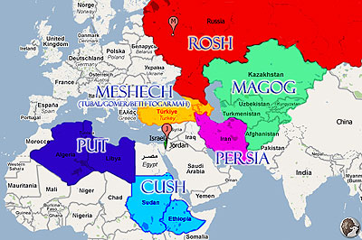
Ezekiel 38 Battle of Magog

Slide 45
Ezekiel 38:5-6 lists nations in alliance w/ Magog
Ancient Nations
Modern Nations
Magog/ Scythians
Persia
Cush
Put
Beth Togarmah
Gomer
Russia
Iran
Sudan/Ethiopia
Libya
Turkey
Eastern Europe

Slide 46
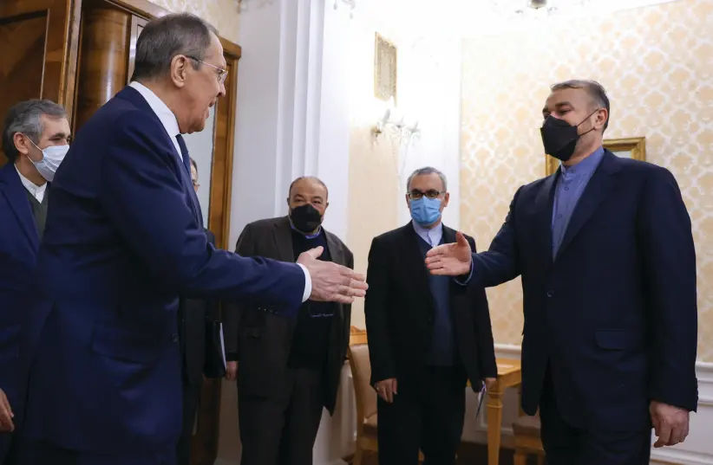
RUSSIAN FOREIGN Minister Sergey Lavrov shakes hands with his Iranian counterpart Hossein Amirabdollahian during a meeting in Moscow last month.
China, Russia and Iran seek joint economic
and trade coordination, and give this aspect
the highest priority, as all three parties believe
that the US is not willing to engage in new wars.
.

Slide 47
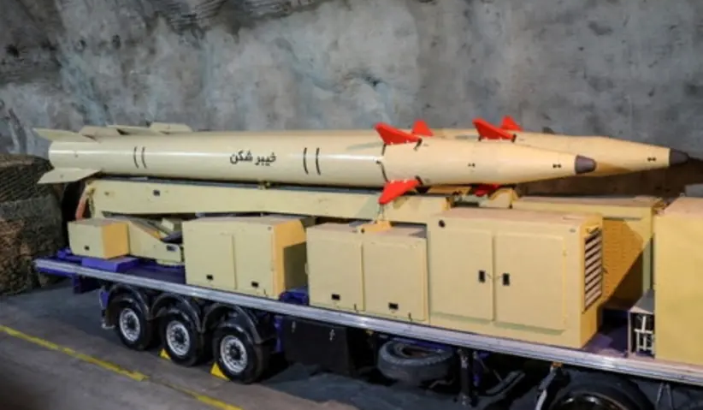
missile naNew Iranian missile, named after battle of Khaybar, is designed to reach Israel.
Iran announced a new missile this week that it claims has a range of 1,450 kilometers, which means it can reach Israel from western Iran. The missile is called “Khaybarshekan” or “Khaybar breaker,” apparently a reference to a historic battle against Jews in the early Islamic period.
The chant “Khaybar, Khaybar ya yahud” is often used as part of antisemitic chants in the region, encouraging the mass murder or genocide of Jews.
Clearly, the name is thus used to describe the warrior qualities that Iran believes it possesses, and which it references with names from the early Islamic period. It matters whether this is all packaged in this new missile as a direct threat to Israel, because Tehran has announced a range that clearly means it can reach the Jewish state.
Iran’s purpose is to threaten but using coded language. It has toned down some of its threats against Israel in recent weeks, however, as it awaits the outcome of the Vienna nuclear talks.
Notes:
By SETH J. FRANTZMAN
Published: FEBRUARY 9, 2022 14:07
Updated: FEBRUARY 9, 2022 17:33

Slide 48
New Iranian missile named after battle of Khaybar is designed to reach Israel.
Iran announced a new missile this week that it claims has a range of 1,450 kilometers, which means it can reach Israel from western Iran. The missile is called “Khaybarshekan” or “Khaybar breaker,” apparently a reference to a historic battle against Jews in the early Islamic period.
The chant “Khaybar, Khaybar ya yahud” is often used as part of antisemitic chants in the region, encouraging the mass murder of genocide of Jews.
Clearly, the name is thus used to describe the warrior qualities that Iran believes it possesses, and which it references with names from the early Islamic period. It matters whether this is all packaged in this new missile as a direct threat to Israel, because Tehran has announced a range that clearly means it can reach the Jewish state.
Iran’s purpose is to threaten but using coded language. It has toned down some of its threats against Israel in recent weeks, however, as it awaits the outcome of the Vienna nuclear talks.
Notes:
By SETH J. FRANTZMAN
Published: FEBRUARY 9, 2022 14:07
Updated: FEBRUARY 9, 2022 17:33

Slide 49
Spiritual Lens
Ukraine has the highest percentage of evangelical Christians in the former USSR and continental Europe. They have the largest concentration of evangelical churches in Eastern Europe.
Russians invade Ukraine committing war- crimes, but God is intervening.

Slide 50
Ephesians 3:16-21
¹⁶ I pray that out of his glorious riches he may strengthen you with power through his Spirit in your inner being, ¹⁷ so that Christ may dwell in your hearts through faith. And I pray that you, being rooted and established in love, ¹⁸ may have power, together with all the Lord’s holy people, to grasp how wide and long and high and deep is the love of Christ, ¹⁹ and to know this love that surpasses knowledge—that you may be filled to the measure of all the fullness of God.
²⁰ Now to him who is able to do immeasurably more than all we ask or imagine, according to his power that is at work within us, ²¹ to him be glory in the church and in Christ Jesus throughout all generations, for ever and ever! Amen.

Slide 51
Proverbs 3:3-6 NIV
³ Let love and faithfulness never leave you;
bind them around your neck,
write them on the tablet of your heart.
⁴ Then you will win favor and a good name
in the sight of God and man.
⁵ Trust in the Lord with all your heart
and lean not on your own understanding;
⁶ in all your ways submit to him,
and he will make your paths straight.[

Slide 52
Alternative version
Do not let truth and mercy leave you; bind them around your neck, write them on the tablet of your heart. Proverbs 3:3
“Truth is incontrovertible. Panic may resent it. Ignorance may deride it. Malice may distort it . But there it is.”

Slide 53
Solzhenitsyn
When violence bursts onto the peaceful human condition, its face is flush with self-assurance, it displays on its banner and proclaims: “I am Violence! Make way, step aside, I will crush you!” But violence ages swiftly, a few years pass—and it is no longer sure of itself. To prop itself up, to appear decent, it will without fail call forth its ally—Lies. For violence has nothing to cover itself with but lies and lies can only persist through violence. And it is not every day and not on every shoulder that violence brings down its heavy hand: It demands of us only a submission to lies, a daily participation in deceit—and this suffices as our fealty.

Slide 54
Live Not By Lies
And therein we find, neglected by us, the simplest, the most accessible key to our liberation: a personal nonparticipation in lies! Even if all is covered by lies, even if all is under their rule, let us resist in the smallest way: Let their rule hold not through me!
And this is the way to break out of the imaginary encirclement of our inertness, the easiest way for us and the most devastating for the lies. For when people renounce lies, lies simply cease to exist.
Our way must be: Never knowingly support lies!
Notes:
-- by Edward E. Ericson, Jr. and Daniel J. Mahoney, The Solzhenitsyn Reader

Slide 55
Europe’s energy problem
Putin knows that Europe produces 3.6 million barrels of oil a day but uses 15 million barrels of oil a day. Putin knows that Europe produces 230 billion cubic meters of natural gas a year but uses 560 billion cubic meters. He knows that Europe uses 950 million tons of coal a year but produces half that.
The former KGB agent knows Russia produces 11 million barrels of oil per day but only uses 3.4 million. He knows Russia now produces over 700 billion cubic meters of gas a year but only uses around 400 billion. Russia mines 800 million tons of coal each year but uses 300.
That’s how Russia ends up supplying about 20 percent of Europe’s oil, 40 percent of its gas, and 20 percent of its coal.
Notes:
The West’s Green Delusions Empowered Putin
While we banned plastic straws, Russia drilled and doubled nuclear energy production.
Michael Shellenberger

Slide 56
THE question is Why?
The reason Europe didn’t have a muscular deterrent threat
to prevent Russian aggression—and in fact pevented the U.S.
from getting allies to do more—is that it needs Putin’s oil and gas.
How is it possible that European countries, Germany
especially, allowed themselves to become so dependent
on an authoritarian country over the 30 years
since the end of the Cold War?

Slide 57
Green Ideology
Here’s how: These countries are in the grips of a delusional ideology that makes them incapable of understanding the hard realities of energy production. Green ideology insists we don’t need nuclear and that we don’t need fracking. It insists that it’s just a matter of will and money to switch to all-renewables—and fast. It insists that we need “degrowth” of the economy, and that we face looming human “extinction.” (I would know. I myself was once a true believer.)

Slide 58
Green climate initiatives Cost
The upshot here is that you can’t spend enough on climate initiatives to fix things if you ignore nuclear and gas. Between 2015 and 2025, Germany’s efforts to green its energy production will have cost $580 billion. Yet despite this enormous investment, German electricity still costs 50 percent more than nuclear-friendly France’s, and generating it produces eight times more carbon emissions per unit. Plus, Germany is already getting over a third of its energy from Russia.
Berlin was faced with a choice between unleashing the wrath of Putin on neighboring countries or inviting the wrath of Greta Thunberg. They chose Putin.
Who sells 80% of the solar panels the US will be buying so we won’t upset Greta Thunberg? What country will we be dependent on?

Slide 59
Potter’s House
Jeremiah 18:6-11
⁶ He said, “Can I not do with you, Israel, as this potter does?” declares the Lord. “Like clay in the hand of the potter, so are you in my hand, Israel. ⁷ If at any time I announce that a nation or kingdom is to be uprooted, torn down and destroyed, ⁸ and if that nation I warned repents of its evil, then I will relent and not inflict on it the disaster I had planned. ⁹ And if at another time I announce that a nation or kingdom is to be built up and planted, ¹⁰ and if it does evil in my sight and does not obey me, then I will reconsider the good I had intended to do for it.
¹¹ “Now therefore say to the people of Judah and those living in Jerusalem, ‘This is what the Lord says: Look! I am preparing a disaster for you and devising a plan against you. So turn from your evil ways, each one of you, and reform your ways and your actions.’

Slide 60
Two smoldering stubs of firewood
So the hearts of Ahaz and the people were shaken as trees are shaken by the wind.
Say to Ahaz, Be careful, keep calm, and don’t be afraid. Do not lose heart because of these two smoldering stubs of firewood.
This is what the Lord says to me…warning me not to follow the way of the people: Do not call conspiracy everything this people calls a conspiracy; don’t fear what they fear…The Lord almighty is the one your are to regard as holy, He is the one you are to fear….Is 8:11-12
I will wait for the Lord, who is hiding his face from the descendants of Jacob. I will put my trust in Him. Isaiah 8:17

Slide 61
The Lofty Trees
This is what the great king, the king of Assyria, says: On what are you basing this confidence of yours? 36:4
¹³ Then the commander stood and called out in Hebrew, “Hear the words of the great king, the king of Assyria! ¹⁴ This is what the king says: Do not let Hezekiah deceive you. He cannot deliver you! ¹⁵ Do not let Hezekiah persuade you to trust in the Lord when he says, ‘The Lord will surely deliver us; this city will not be given into the hand of the king of Assyria.’

Slide 62
Stump of Jesse
He will strike the earth with the rod of his mouth; with the breath of his lips, he will slay the wicked. Righteousness will be his belt and Faithfulness the sash around His waist. Isaiah 11:4b-5
And then the lawless one will be revealed, whom the Lord Jesus will overthrow with the breath of His mouth and destroy by the splendor of his coming. II Thessalonians 2:8

Slide 63
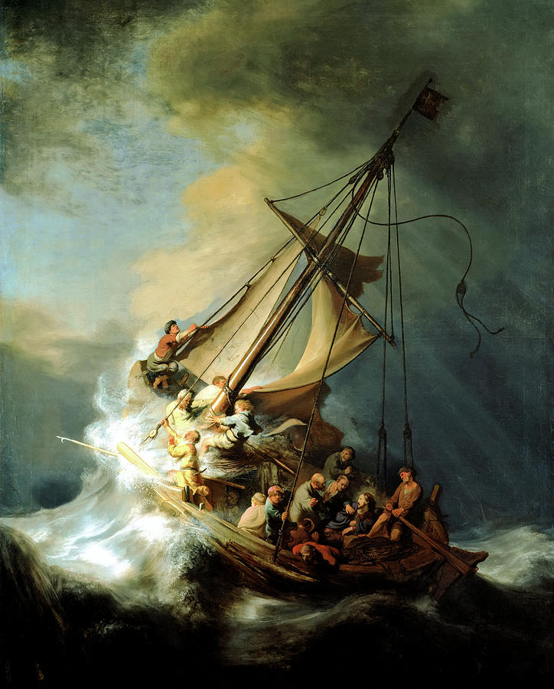
Do not be AFRAID

Slide 64
Vaclav Havel-Value nothing more than Truth
Czech playwright and future post communist president Vaclav Havel’s most famous injunction to would-be dissidents was to “live in Truth.”
In his most important political writing, Havel wrote about “the power of the powerless,” which was the essay’s title.
A person who lives only for his own comfort and survival and who is willing to live within a lie to protect that, is, says Haval, “a demoralized person.”
The system depends on this demoralization…Living within the TRUTH, as humanity’s revolt against an enforced position, is, on the contrary, an attempt to regain control over one’s own sense of responsibility.
He is the WAY, THE TRUTH AND THE LIFE…For in Him we LIVE and
MOVE and have our BEING….
He published that essay in 1978 and within a year communist govt. returned him to prison. Ten years later, Havel led a revolution that peacefully toppled the regime and became the first president of a free Czechoslovakia.
Notes:
Live not by lies , 97-99

Slide 65
The power of the powerless
Why is religion and the hope it gives at the core of effective resistance?
What does the willingness to suffer have to do with living in truth?
Why is the family the most important cell of opposition?
How does faithful fellowship provide resilience in the face provide resilience in the face of persecution?
How did oppressed families keep their faith, their integrity, even their sanity and protect their families?

Slide 66
The Family and the Totalitarian State
In the Christian Model, Marriage and Family offers three gifts:
The first fruit is the fruitful fellowship of love; we are bound together by virtue of our closeness; not based on merit, rights and entitlements, but by virtue of mutual need and its affectionate reciprocation
Freedom given to us so absolutely that even as finite and, during the conditions of the world, seemingly rooted beings, we can make permanent, eternal decisions: every marriage promise kept, every fidelity in defiance of adversity…
The gift of dignity: all other social roles we are replaceable and can be replaceable. The cold calculation of justice doesn’t reign between husband and wife, parent and child, but rather the law of love.
Prepare your family to make great sacrifices for the Greater good. We may not see the positive consequences of our suffering, But there is a good God who will eventually win in the End. Kamila Benda: No better off staying
Notes:
LNBL-p.140

Slide 67
Ephesians 1:18-23
¹⁸ I pray that the eyes of your heart may be enlightened in order that you may know the hope to which he has called you, the riches of his glorious inheritance in his holy people, ¹⁹ and his incomparably great power for us who believe. That power is the same as the mighty strength ²⁰ he exerted when he raised Christ from the dead and seated him at his right hand in the heavenly realms, ²¹ far above all rule and authority, power and dominion, and every name that is invoked, not only in the present age but also in the one to come. ²² And God placed all things under his feet and appointed him to be head over everything for the church, ²³ which is his body, the fullness of him who fills everything in every way.

Slide 68
Critical race theory is fast becoming America’s new institutional orthodoxy.
Originally, the Marxist left built its political program on the theory of class conflict. Karl Marx believed that the primary characteristic of industrial societies was the imbalance of power between capitalists and workers. The solution to that imbalance, according to Marx, was revolution: The workers would eventually gain consciousness of their plight, seize the means of production, overthrow the capitalist class and usher in a new socialist society.
During the 20th century, a number of regimes underwent Marxist-style revolutions ended in disaster. Socialist governments in the Soviet Union, China, Cambodia, Cuba and elsewhere racked up a body count of nearly 100 million people. They are remembered for gulags, show trials, executions and mass starvations. In practice, Marx’s ideas unleashed man’s darkest brutalities.

Slide 69
CRT is Marxist Ideology applied through racism
Marxist analysis of society divided by oppressors and oppressed.
The oppressed impede revolution when they adhere to the cultural beliefs of their oppression
Concomitant and need to dismantle all societal norms through relentless criticism
The replacement of all systems of power and even the descriptions of those systems with a worldview that describes only oppressors and the oppressed.
Notes:
P87 America Marxism

Slide 70
Dangerous Combination
Why is this important? Because we have to note that critical race theory is the brainchild not of grassroots upswell, but Northeastern managerial elites. Critical race theory gained steam at Harvard Law, and married into the managerial attitudes of its neighbor Harvard Business School, which sought to eliminate inefficiencies in human relations by grouping and managing.
Managerialism at Harvard preached “a largely anonymous ‘technostructure’ of business leaders [that] could dictate to consumers what to buy and, implicitly, how to live.” The politically entrepreneurial critical race theorists combined that with grouping people by race and formed the basis of a managerial racialism that grouped people into privileged and oppressed classes, each with specific actions of racial solidarity or repentance to perform.
Harvard’s intertwinement with critical race theory continues to the present day. This is most clearly expressed in Harvard’s discrimination against Asian applicants, the subject of a lawsuit against the school. According to critical race theory, any racial inequity is evidence of systemic racism. Thus, the higher percentage of Asian Americans in the student body compared to the overall U.S. population must be “fixed” by discriminating against Asian-American applicants on the basis of race.

Slide 71
Jeremiah 17:5-8
⁵ This is what the Lord says:
“Cursed is the one who trusts in man,
who draws strength from mere flesh
and whose heart turns away from the Lord.
⁶ That person will be like a bush in the wastelands;
they will not see prosperity when it comes.
They will dwell in the parched places of the desert,
in a salt land where no one lives.
⁷ “But blessed is the one who trusts in the Lord,
whose confidence is in him.
⁸ They will be like a tree planted by the water
that sends out its roots by the stream.
It does not fear when heat comes;
its leaves are always green.
It has no worries in a year of drought
and never fails to bear fruit.”

Slide 72
Hebrews 10:35-39
³⁵ So do not throw away your confidence; it will be richly rewarded.
³⁶ You need to persevere so that when you have done the will of God, you will receive what he has promised. ³⁷ For,
“In just a little while,
he who is coming will come
and will not delay.”^{[a]}
³⁸ And,
“But my righteous^{[b]} one will live by faith.
And I take no pleasure
in the one who shrinks back.”^{[c]}
³⁹ But we do not belong to those who shrink back and are destroyed, but to those who have faith and are saved.

Slide 74
Conclusion: How can I take a step toward being grateful?
My focus started with the smaller “everyday resentments,”
Any action we take to move away from resentment is a step toward gratitude.
Gratitude has the amazing power to illuminate where its missing.
We need to acknowledge it…give it a voice, a shape, a place w/out shame or guilt.
Only then can we see how much resentment is robbing us of our gratitude and potentially destroying our relationships and sense of well-being.

Slide 75
Critical race theorists must be confronted with and forced to speak to the facts. Do they support public schools separating first-graders into groups of “oppressors” and “oppressed”? Do they support mandatory curricula teaching that “all white people play a part in perpetuating systemic racism”? Do they support public schools instructing white parents to become “white traitors” and advocate for “white abolition”? Do they want those who work in government to be required to undergo this kind of re-education? How about managers and workers in corporate America? How about the men and women in our military?

Slide 76
Critical Race Theory Origin
The most important thinkers of the group of critical legal theorists were all Harvard Law professors: Derrick Bell, Roberto Unger, Duncan Kennedy, and Morton Horwitz.
The main tenets of the philosophy included that justice is inherently subjective, the law is nothing but a political tool, and the system will only ever provide good outcomes for the wealthy and privileged. Their proposed solution was to overthrow Western liberal society. To this point, Unger wrote:
Liberalism must be seen all of a piece, not just as a set of doctrines about the disposition of power and wealth, but as a metaphysical conception of the mind and society. Only then can its true nature be understood, and its secret empire overthrown.

Slide 77
Wokeness
People being forced to adopt progressive beliefs about identity, race, and gender theory. If we don’t do so, we face being canceled or at least labeled as racist or bigoted.
This belief system has infiltrated institutions of higher learning, public schools, media, sports, entertainment, military, medicine and corporations.
People who grew up under communism are seeing a society when people are afraid to say what they think for fear of losing their jobs or being sent to the social margins, where only one opinion tolerated, regardless if from governments or institutions its totalitarianism.

Slide 78
The old totalitarianism(Russia & China) achieved control by inflicting pain and terror and fear on people to make them conform. But the current brand of totalitarianism uses comfort to control people.
Hannah Arendt, German Jew found German Nazism and Russian communism used atomization of the individual and mass loneliness were at the root of both movements.
Other factors that contribute to totalitarianism taking hold was that people lost faith in their religion and in authority figures.This is widespread in our society today left and right.
When we lose the desire to know the truth, even if the truth hurts, even if the truth goes against what we want to believe…we are opening the door to totalitarianism.
Totalitarianism eliminates anything that gets in the way of controlling the individual…Parents, Church, religion. Mao and Stalin, Hitler demanded ideological purity.
Communists try to destroy history and culture and we see that happening with critical race theory and 1619 project.

Slide 79
Eternal vigilance is the price of liberty

Slide 80
But rather than abandon their political project, Marxist scholars in the West simply adapted their revolutionary theory to the social and racial unrest of the 1960s. Abandoning Marx’s economic dialectic of capitalists and workers, they substituted race for class and sought to create a revolutionary coalition of the dispossessed based on racial and ethnic categories.
Fortunately, the early proponents of this revolutionary coalition in the US lost out in the 1960s to the civil rights movement, which sought instead the fulfillment of the American promise of freedom and equality under the law.
Americans preferred the idea of improving their country to that of overthrowing it. Martin Luther King Jr.’s vision, President Lyndon Johnson’s pursuit of the Great Society,

Slide 81
Michael Nutter: Larry Krasner owes an apology to the 521 families of Philly’s homicide victims | Opinion
Philadelphia’s reformist district attorney, Larry Krassner, who is white, the top prosecutor said at a December news conference that “We don’t have a crisis of lawlessness, we don’t have a crisis of crime, we don’t have a crisis of violence.”
Former Philadelphia Mayor Nutter who is black, wrote that “it takes a certain audacity of ignorance and white privilege to say that right now. As of Monday night, 521 people, souls, spirits have been vanquished, eliminated, murdered in our City of Brotherly Love and Sisterly Affection, the most since 1960.
A December CNN poll found 76 percent of Americans said the federal government was not doing enough to address violent crime.
Notes:
by Michael A. Nutter, For The InquirerUpdated Dec 7, 2021

Slide 82
¹⁶ This is what the Lord says:
“Stand at the crossroads and look;
ask for the ancient paths,
ask where the good way is, and walk in it,
and you will find rest for your souls.
But you said, ‘We will not walk in it.’
¹⁹ Hear, you earth:
I am bringing disaster on this people,
the fruit of their schemes,
because they have not listened to my words
and have rejected my law.

Slide 83
U.S Border terrorist watch list
AUSTIN, Texas — Law enforcement intercepted 14 illegal immigrants at the U.S.-Mexico border who were on the terrorist watchlist, a former top official said, more than the four stops that the Department of Homeland Security had disclosed.:3:17
The terror watchlist stops in 2021 are significant because they are higher than in previous years. U.S. Customs and Border Protection, the parent agency of the Border Patrol, declined to comment or release data on terror watchlist encounters.
Last summer, Scott told agents in a farewell address that the agency was encountering people on the terror watchlist “at a level we have never seen before.” 14 people he referenced were identified as known or suspected terrorists, according to the Terrorism Screening Center’s Terrorist Screening Database. The database lists people who have concrete affiliations with terrorist organizations and have carried out or plan to carry out terrorism, as well as people suspected of the same activities…Feds patrolling the 2,000-mile-long U.S.-Mexico border are increasingly on alert for foreigners on the terror watch list, given the situation in Afghanistan, a senior official at U.S. Customs and Border Protection

